Slide 1
Java static keyword
Instructor :Prashant Mishra
BIAS Bhimtal

Slide 2
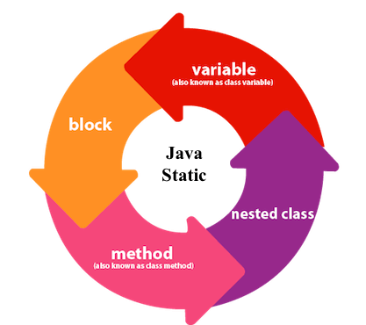

Slide 3
The static keyword in Java is used for memory management mainly. We can apply java static keyword with variables, methods, blocks and nested class. The static keyword belongs to the class than an instance of the class.
The static can be:
Variable (also known as a class variable)
Method (also known as a class method)
Block
Nested class

Slide 4
Java static variable
If you declare any variable as static, it is known as a static variable.
The static variable can be used to refer to the common property of all objects (which is not unique for each object), for example, the company name of employees, college name of students, etc.
The static variable gets memory only once in the class area at the time of class loading.
Advantages of static variable
It makes your program memory efficient (i.e., it saves memory).

Slide 5
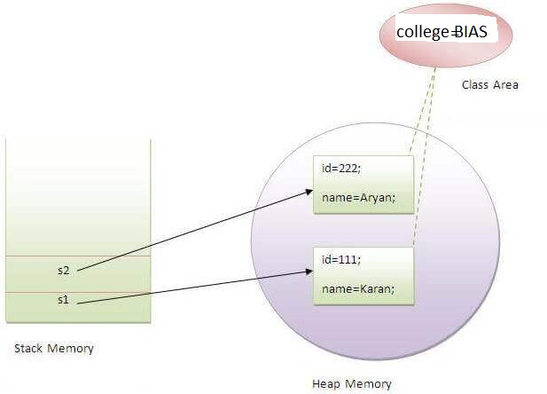
Understanding the problem without static variable
class Student{
int rollno;
String name;
String college=“BIAS";
}
Suppose there are 500 students in my college, now all instance data members will get memory each time when the object is created. All students have its unique rollno and name, so instance data member is good in such case. Here, "college" refers to the common property of all objects. If we make it static, this field will get the memory only once.

Slide 6
Program of the counter without static variable
//Java Program to demonstrate the use of an instance variable
//which get memory each time when we create an object of the class.
class Counter{
int count=0;//will get memory each time when the instance is created
Counter(){
count++;//incrementing value
System.out.println(count);
}
public static void main(String args[]){
//Creating objects
Counter c1=new Counter();
Counter c2=new Counter();
Counter c3=new Counter();
}
}
Output:
1
1
1

Slide 7
Program of counter by static variable
//Java Program to illustrate the use of static variable which
//is shared with all objects.
class Counter2{
static int count=0;//will get memory only once and retain its value
Counter2(){
count++;//incrementing the value of static variable
System.out.println(count);
}
public static void main(String args[]){
//creating objects
Counter2 c1=new Counter2();
Counter2 c2=new Counter2();
Counter2 c3=new Counter2();
}
}
Output:
1
2
3

Slide 8
Java static method
If you apply static keyword with any method, it is known as static method.
A static method belongs to the class rather than the object of a class.
A static method can be invoked without the need for creating an instance of a class.
A static method can access static data member and can change the value of it.

Slide 9
Example of static method
//Java Program to demonstrate the use of a static method.
class Student{
int rollno;
String name;
static String college = "ITS";
//static method to change the value of static variable
static void change(){
college = “BIAS";
}
//constructor to initialize the variable
Student(int r, String n){
rollno = r;
name = n;
}
//method to display values
void display(){System.out.println(rollno+" "+name+" "+college);}
}

Slide 10
//Test class to create and display the values of object
public class TestStaticMethod{
public static void main(String args[]){
Student.change();//calling change method
//creating objects
Student s1 = new Student(111,"Karan");
Student s2 = new Student(222,"Aryan");
Student s3 = new Student(333,"Sonoo");
//calling display method
s1.display();
s2.display();
s3.display();
}
}
Output:111 Karan BIAS
222 Aryan BIAS
333 Sonoo BIAS

Slide 11
//Java Program to get the cube of a given number using the static method
class Calculate{
static int cube(int x){
return x*x*x;
}
public static void main(String args[]){
int result=Calculate.cube(5);
System.out.println(result);
}
}

Slide 12
Restrictions for the static method:
There are two main restrictions for the static method. They are:
The static method can not use non static data member or call non-static method directly.
this and super cannot be used in static context.

Slide 13
Java static block
Is used to initialize the static data member.
It is executed before the main method at the time of class loading.
class A2{
static{System.out.println("static block is invoked");}
public static void main(String args[]){
System.out.println("Hello main");
}
}
Output: static block is invoked
Hello main

Slide 14
Can we execute a program without main() method?
Ans) No, one of the ways was the static block, but it was possible till JDK 1.6. Since JDK 1.7, it is not possible to execute a java class without the main method.

